Slide 1


MavPass Exam Review
4/ 28/ 22

Slide 2
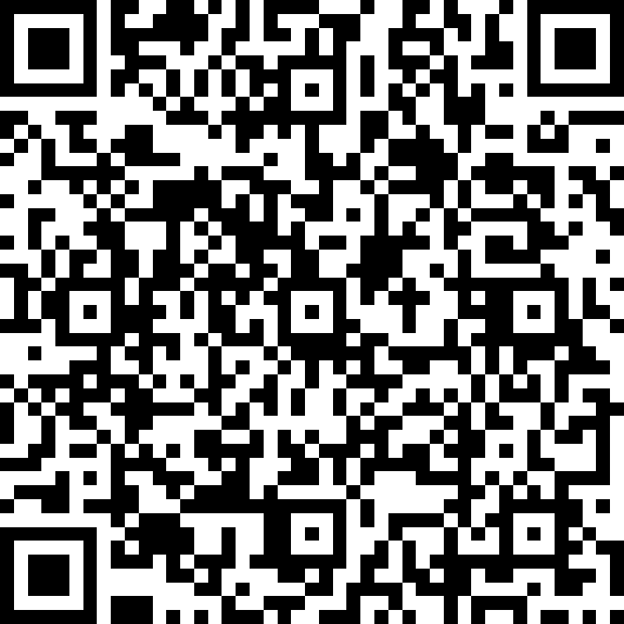
Attendance CIS121 MavPASS Session
https://forms.office.com/pages/responsepage.aspx?id=xscRULQKq0ae9PrnSpIaf8Jeg9NwiYFJtEEipPejT79UNkFaVjJCV1YxWDVWV0NJRTVMOUFQUTlPUSQlQCN0PWcu

Slide 3

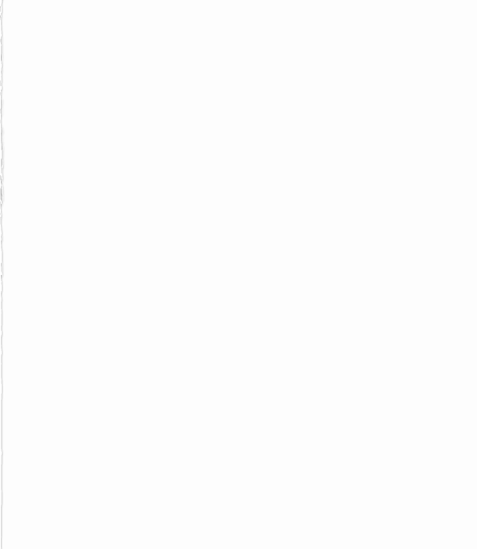
Ice breaker
Write a program that will take a positive number and print from it to -20.

Slide 4
What do we know so far ?
Write a code that print multiplication table for each numbers from 1 to 10
And try to print it by creating a new text file
Example ->
1,2,3,4,5,6,7,8,9,10. 2,4,6,8,10,12,14,16,18,20. 3,6,9,12,15,18,21,24,27,30. 4,8,12,16,20,24,28,32,36,40. 5,10,15,20,25,30,35,40,45,50. 6,12,18,24,30,36,42,48,54,60. 7,14,21,28,35,42,49,56,63,70. 8,16,24,32,40,48,56,64,72,80.

Slide 5
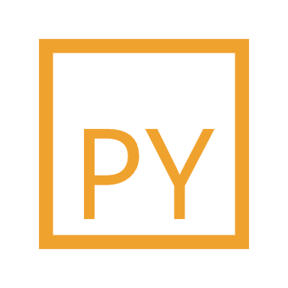
what is object oriented programming in python
Object-oriented programming (OOP) is a method of structuring a program by bundling related properties and behaviors into individual objects. In this tutorial, you'll learn the basics of object-oriented programming in Python. Conceptually, objects are like the components of a system.

Slide 6
Example
Create a calculator that can do addition and substruction using OOP
Write and test a program that computes the area of a circle. The program should request a number representing a radius as input from the user. Using OOP

Slide 7
What are Inheritance and data encapsulation

Slide 8
What is Recursion function
can you tell why we use recursion than nested loop

Slide 9
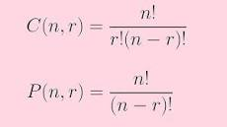
Practice problem
1, Write a code that do combination and permutation using OOP
2, Given two non-empty arrays of integers, write a function that determines whether the second array is a subsequence of the first one.

Slide 10


Get and set
Create a banking system including checking and savings accounts. Users have the ability to make deposits and withdrawals from their accounts. Give the option to transfer money as well.

Slide 11

Study tip:
Give yourself enough time to study.
Organize your study space.
Practice on old exams

Slide 12


Thank You
Amir Abaraya
amir.abaraya@mnsu.edu

